Slide 1

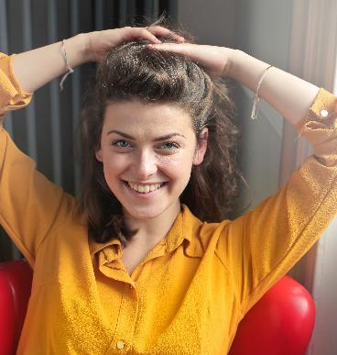


Predicting Happiness
Viviana V. Roseth
March 13, 2020

Slide 2



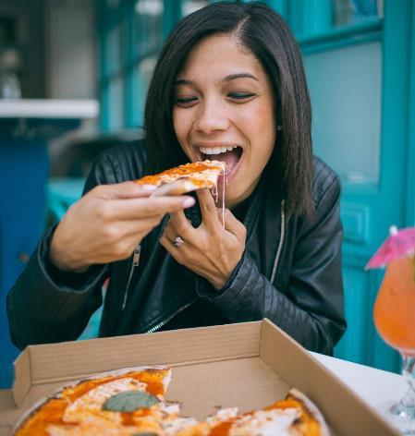

Slide 2
2. The data
1. Definition
3. The process
4. The results

Slide 3
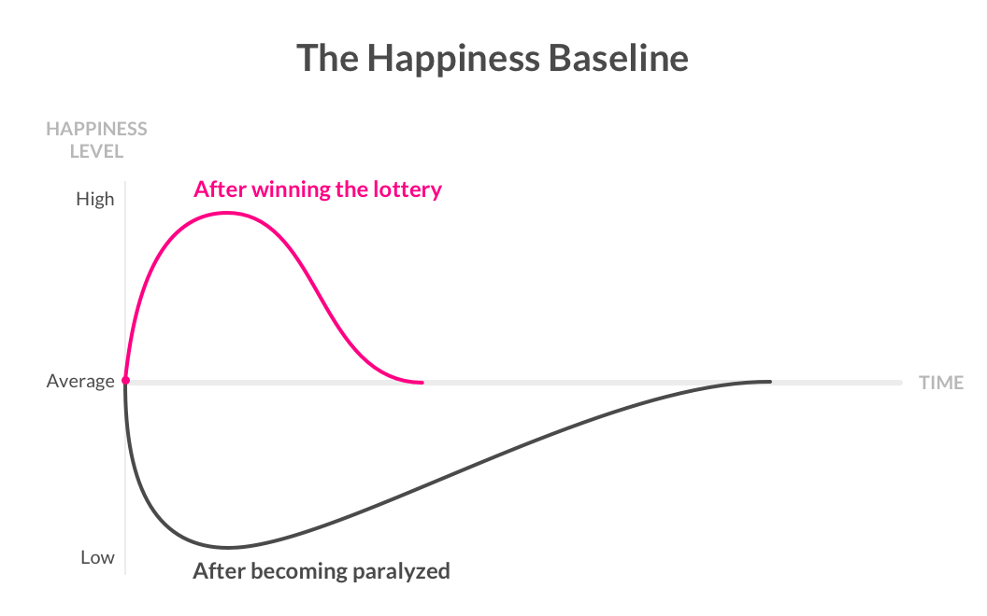

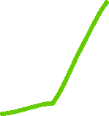

1. What is happiness?
“The experience of joy, contentment, or positive well-being, combined with a sense that one’s life is good, meaningful, and worthwhile.”
Sonja Lyubomirsky – The How of Happiness
Intentional activities
Life circumstances

Slide 4
2. The data
Source: World Bank, 2016

Slide 5


2. The data
2617
1162
Respondents
Features

Slide 6
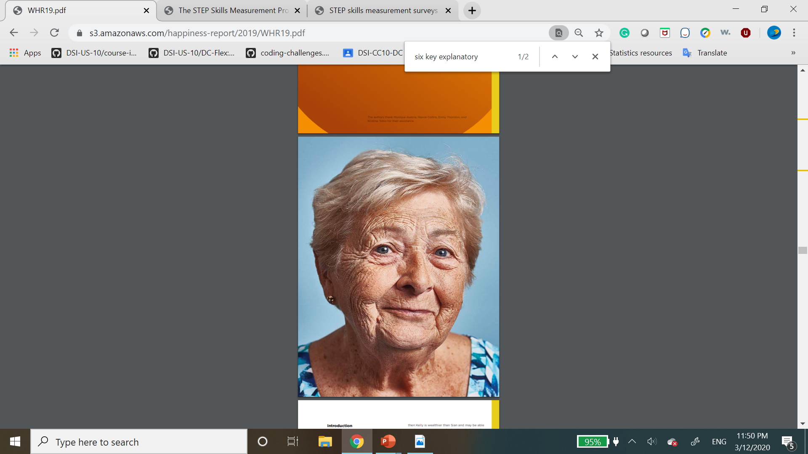



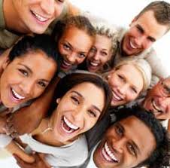
3. The process
3.Exploration of correlations
5.Results
1. Feature Selection
2. Exploration of sample characteristics
4. Generation of predictions

Slide 7
3. The process
1. Feature selection
Survey administration, redundant, duplicated features
7 Categories: Health, Wealth, Education, Work, Personality, Family, Personal characteristics
1162
72
Internal correspondences, missing values, feature condensation

Slide 8
3. The process
2. Exploration of sample characteristics

Slide 9
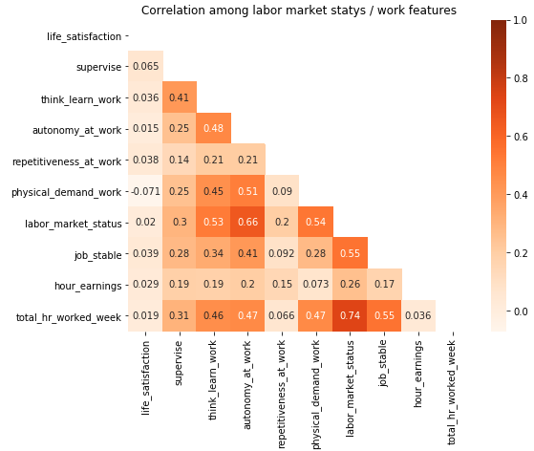
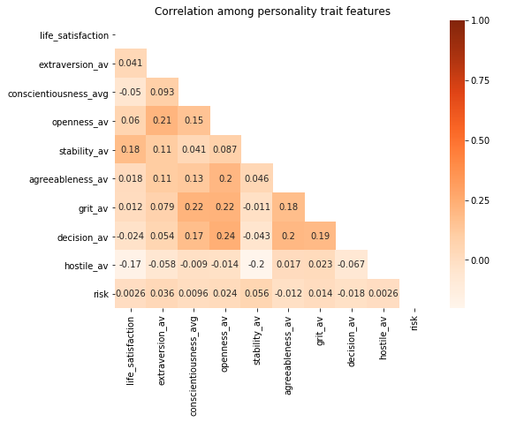
3. The process
3. Exploration of correlations

Slide 10
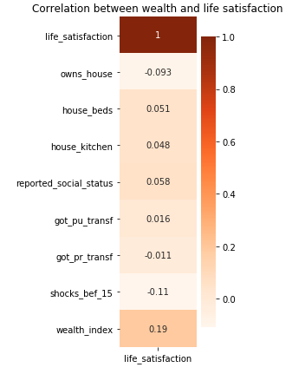
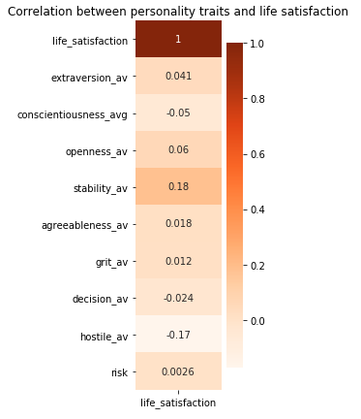
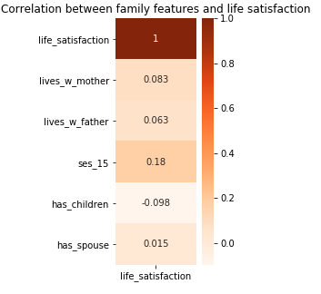
3. The process
3. Exploration of correlations

Slide 11
3. The process
4. Generation of predictions
Y
“In 1-10 scale, where 1 is completely dissatisfied, how satisfied are you at present with your life, all things considered?”
Range from 0 to 10
Logistic regression
K-Nearest Neighbors
Decision trees
Random forest
Unhappy = 0
Happy = 1

Slide 12
4. The results
Range from 0 to 10
 | Multi-class classification
 | Cross-validation score | Train score | Test score | Difference
Linear Regression | 8.30% | 16.08% | 8.06% | 8.02%
Multiclass Logreg (Lasso) | 28.19% | 31.96% | 29.47% | 2.49%
KNN - n=20, alg=auto | 24.16% | 33.43% | 23.82% | 9.61%
DecisionTree max_depth=2, min_sam_split = 2, min_samp_leaf = 2 | 26.66% | 28.34% | 28.85% | -0.51%
Random Forest max_depth=5, min_sam_split = 50, min_samp_leaf = 5 | 27.21% | 32.57% | 27.48% | 5.09%

Slide 13
4. The results
Unhappy = 0
Happy = 1
 | Binary classification
 | Cross-validation score | Train score | Test score | Difference
Multiclass Logreg (Lasso) | 86.95% | 86.95% | 87.02% | -0.07%
KNN - n=20, alg=auto | 85.53% | 88.28% | 86.41% | 1.87%
DecisionTree max_depth=2, min_sam_split = 2, min_samp_leaf = 2 | 77.17% | 86.95% | 87.02% | -0.07%
Random Forest max_depth=5, min_sam_split = 50, min_samp_leaf = 5 | 86.95% | 86.95% | 87.02% | -0.07%

Slide 14



Slide 6
5. What’s next
Additional Techniques (PCA, generalized linear models)
Include other STEP countries. Explore adding OECD countries
Explore cohort differences

Slide 15



Thank You
Viviana V. Roseth
vvroseth@gmail.com
Template by: Jens Martensson
jens@bellowscollege.com

